Slide 2
Deploying and Containerizing Frontend
ORBIT s.r.o. | 2024

Slide 3
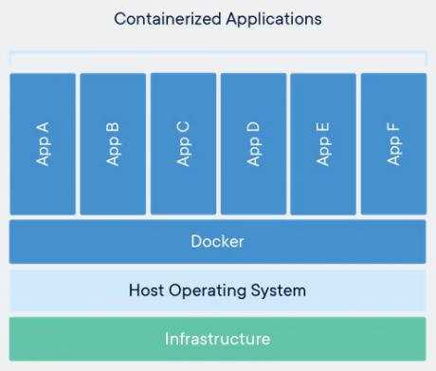
Docker introduction
Container technology, since 2013
Container contains an application and its dependencies – libs, tools...
Container is not VM and doesn’t contain OS
Container is:
Relatively small (hundreds of MBs)
Doesn’t require as much resources
Portable (different environments, OSes)
Exactly defined, repeatable
Starts and stops quickly (seconds)
Stateless, parallel
Not dependent on network settings
Without config (typically delivered by environment variables)

Slide 4
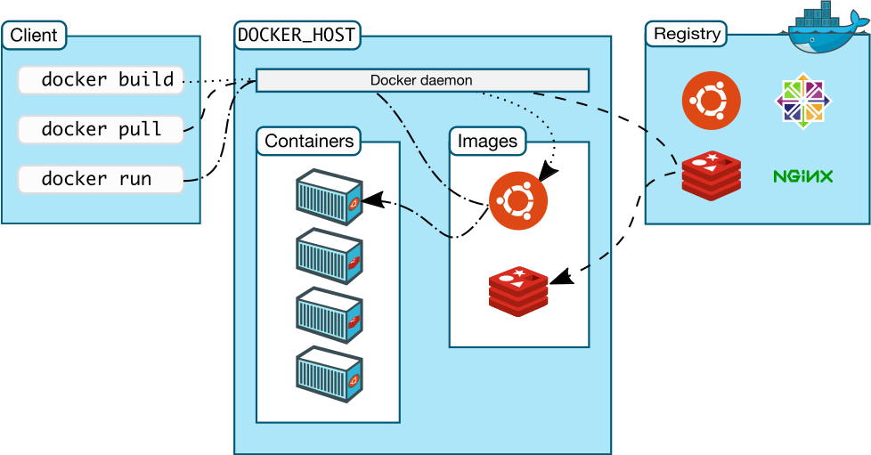
Docker Architecture
Docker Client
Docker Host
Docker Registry
Docker Image
Docker Container (instance)

Slide 5
Dockerfile
A recipe for building a container
FROM debian
ARG FUNCTION_DIR="/opt/backend/"
RUN apt-get update; apt-get -y full-upgrade
RUN apt-get -y install python3-pip
RUN pip3 install fastapi uvicorn
RUN mkdir -p ${FUNCTION_DIR}
WORKDIR ${FUNCTION_DIR}
COPY app/* ${FUNCTION_DIR}
EXPOSE 8000
CMD uvicorn main:app --host 0.0.0.0 --port 8000
we build it using:
docker build -t <name> .
Exercises 1-3

Slide 6
Docker – environment variables
passing config to container
https://12factor.net/config
docker run -e <VAR>=<VALUE>

Slide 7
Docker Volumes
Host filesystem mounted inside docker
Easiest way of providing data to a container
docker volume... # volumes management
docker run –v … # connect volume
docker run –mount … # connect volume – another way

Slide 8
Docker - network 1/2
In general:
Container can communicate with other containers and over network
Application has no idea it’s inside a container
Ports must be published (manually or using orchestration service)
Container gets automatic address for every connected network
DNS must be working!
Network drivers:
bridge - default, standalone containers communicating over network
host - kontejner is not isolated from host and it uses its network (same IP address)
overlay – more docker daemons in distributed virtual networks, not dependend on OS (Docker Swarm)
ipvlan – complete control over addressing, VLANs
macvlan – container has own MAC address, it is seen as a separate device on network
none – container is not connected

Slide 9
Docker – network 2/2
DNS:
you cannot rewrite /etc/hosts during build!
but when runnning: docker run --add-host=<host>:<ip_adresa>...
Bridge:
Default
Container receives a copy of /etc/resolv.conf from host
docker run [--network=bridge]…
all containers are connected to the same network
User defined
docker run --network=<network_name>...
Embedded DNS server, forwards DNS requests to servers definovaned at host
Containers are isolated to those networks
Can be attached/detached when running
docker network create --subnet=192.168.38.0/24 net1
docker network inspect net1
docker network rm net1

Slide 10
Docker backup
Backing up docker instance:
Not a good idea
Good for troubleshooting, development
Maybe not consistent – open files

Slide 11
Docker – storing data
We should use external service for storing data
https://12factor.net/backing-services
In case of AWS cloud it can be:
RDS (database)
DynamoDB, DocumentDB(Mongo)

